Slide 1


<Title>
Infrastructure
as
Code

Slide 2
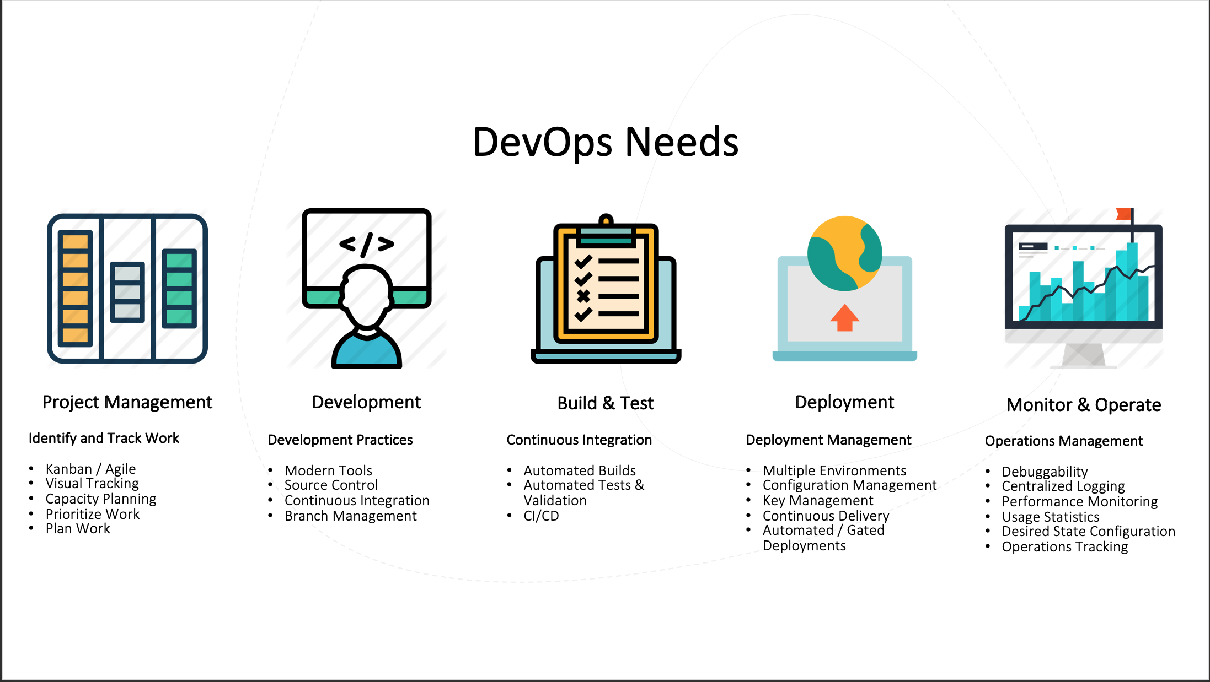
Why Iac?
DevOps World
Business
Developers
Notes:
Business – Chad’s story, deleting stuff, creting new environments
Developers – going from ux to infra

Slide 3
Agenda
What is IaC
Benefits
Challenges
Provision
Management
Demo
Notes:
So this how it’ll go first we’ll define what’s IaC, we’ll talk about some of the benefits and challenges it’s facing, then we’ll move on to the provisioning and management aspect of it and then Terraform which is the new cool thing or the future of IaC and finally we’ll do a demo.

Slide 4
IaC
Infrastructure as Code is a process of managing and provisioning computing infrastructure with some declarative approach while setting their configuration using definition files instead of traditional interactive configuration tools.
Notes:
So what is IaC? I put the official definition in there but in simpler words it means to provision and manage your infrastructure the same way you’d do any other code. And the reason why I keep repeating provision and manage is because these are important parts that make up IaC. We’ll go into more detail about each one later but provisioning is when you actually get your resources to the cloud so getting your vms, vnets, firewalls, etc to the cloud and managing is how they’re configured so how are you going to add all the stuff you need to make the vm usable or up to your business standards

Slide 5
Benefits
Build documentation as you build your code
Cost Reduction
RISK
SPEED
Notes:
IAC can be generally broken down into three, measurable categories: Cost reduction, speed and risk. Cost reduction mainly aims at helping not only the enterprise financially, but also in terms of people and effort, meaning that by removing the manual component, people are able to refocus their efforts towards other enterprise tasks.
https://www.urolime.com/blogs/infrastructure-as-code-iac/
Consistency
Consistently achieve standardised provisioning or deployment
Accelerating
Accelerating provisioning or deployment rapidly
Reusability
Reusable JSON code for repeatable or similar provisioning or deployment
Extensibility
Extensible JSON code for incorporating with additional items
Build documentation as you build your code
Centralized repository with version control
Flexible build process, reusing code that was already used, simple process to expand code for changes/custom deployments
Removes receptive process of building services by automating the process
Faster delivery
Removes human error
Enables site reliablity
Okay benefits, since we’re talking about handling infra the same way you’d do any other code you’re definitely going to have the benefits devops give you such as version control, CI/CD, you can still automate testing and automate backups, and stuff but IaC also has a lot more benefits that I think make it really useful. First you’re going to be able to build your documentation as you do your code, another thing is cost reduction because this makes it super easy to deploy something that you can blow up the resources you’re not using so they’re not charging you, risk is another big benefit because this removed human error, in fact let me tell you a story you know APS is a big client and they need their environments super secure well a few ago we started getting this emails about a vm that someone created with a public ip and no one knew who created it or why which led to everyone freaking out, thankfully it wasn’t any of us so we were good but that is the perfect example of how IaC could’ve avoided it you have your visibility you could’ve immediately known who created the release, if you have a lock you could’ve seen you approved it and stuff like that. Then the final one is speed, we talked about the scenario when you accidentally delete an environment well when you already have that environment all coded then it’s way faster to just deploy it again instead of going to the portal and creating every single resource again.

Slide 6
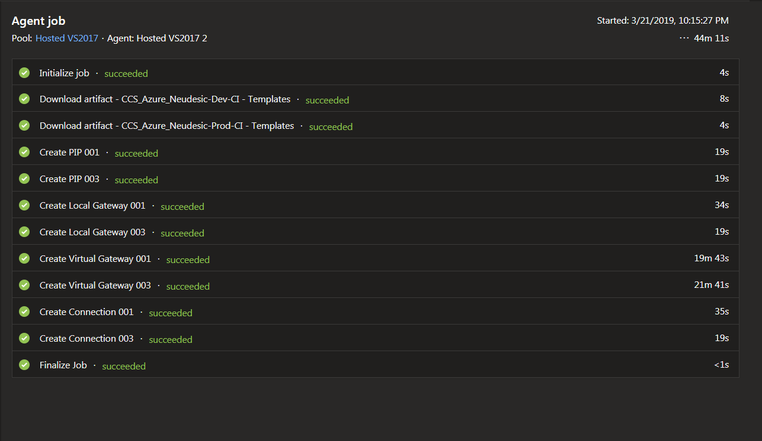
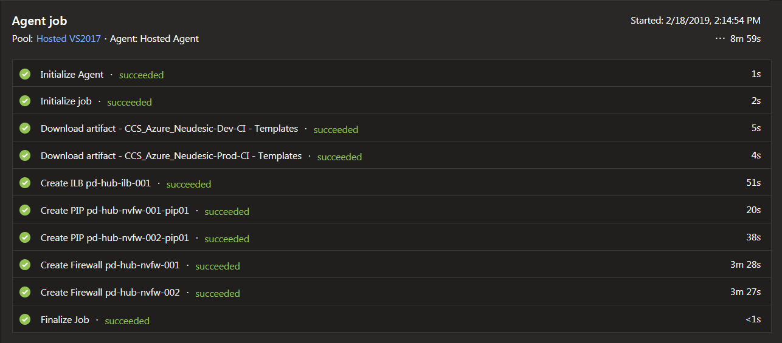



Slide 7
Challenges
Third-Party Software Issues
Maintaining code/configuration mismatch
IaC Learning Curves
Notes:
https://www.urolime.com/blogs/infrastructure-as-code-iac/
https://github.com/MicrosoftDocs/azure-docs/issues/15201
Third-Party Software Issues: The majority of legacy applications on the market were not designed to work with IAC applications. eg. Most third-party Windows applications cannot really be automated via the Windows command line.
Configuration Drift: This occurs when the administrators change the server configurations without changing the associated IAC code. This results in inconsistent configurations across data centre systems but it can be prevented by fully integrating IAC into all policies and procedures relating to systems administration, IT operations, and DevOps processes.
IAC Learning Curves: IAC code only understands what it is programmed to understand, therefore switching from a manual system to a code-based automated system requires more resources, which increases the chances for coding errors. This results in an error in a line of code which can spread across multiple servers, potentially causing significant problems. To solve such issues, it is required to extensively test any pre-release code and monitor released code for any sign of errors.
Challenges! We definitely have some of those! One of the bad things is that since this is relatively new not all applications were designed to work with IaC so you’re going to be facing issues there, another thing is that when you’re not maintaining your code so let’s say you have to change a port or a rule on your load balancer instead of redeploying you think it’s easier to just in the portal and changing it there but forget to update the code because everyone always updates their code right?! And then the last one is that there aren’t that many resources our there and for example the errors you get are sometimes veeery vague like our ASE pipeline failed a few days ago, ASE usually takes around 2 hours and this one went on for 6 hours until it failed and the error we got was just time out and then this one on github that I almost cried about because I kept getting it on different things but couldn’t figure out why!

Slide 8
Provision
Notes:
This is where you start putting things together
CI/CD

Slide 9
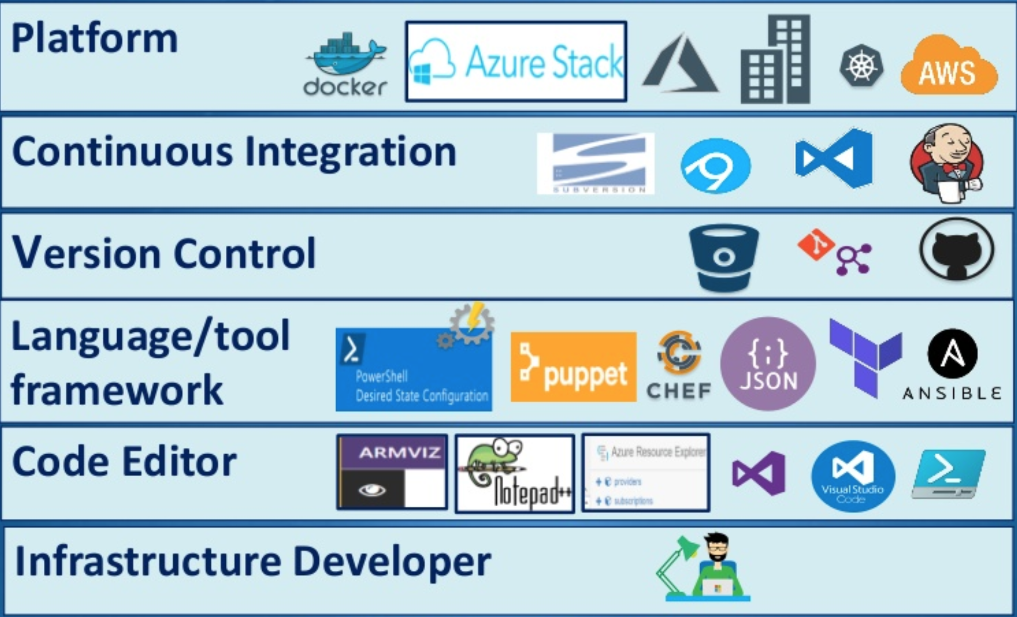
Pipelines
CI – Build
CD – Release
Notes:
So we already talked about what provisioning means now the reason why I liked this picture is because it shows that you have so many options for you to do it and that’s a thing with IaC you definitely have to plan your architecture and choose the tools you’d like to use. For this presentation I’m choosing this stack for obvious reasons haha so in devops I won’t go into a lot of detail about creating the pipelines because I know Rich already did a L&L about it and you should’ve paid attention so I’ll be testing you but I’m going to show you what makes the pipelines unique for infra.

Slide 10
Templates
The PowerShell Experience
Customer: Waiter!
<Wait 1 minute>
Waiter: tWhat would you like sir?
Customer: Could you ask the chef to go to the fridge?
<Wait while the chef is asked to go to the fridge>
Waiter: Yes?
Customer: Would you ask the chef to open the fridge?
<Wait while the chef opens the fridge>
Waiter: Yes?
Customer: Would you ask the chef to take a steak out of the fridge?
<Wait while the chef takes a steak out of fridge>
Waiter: Yes?
Customer: Please ask the check to put a pan on the cooker.
<Wait while the chef pus a pan on the cooker>
Waiter: Yes?
The ARM Experience
Customer: Waiter, I would like a Salmon dish for my wife and steak for myself.
Waiter: Yes, sir, in the meantime, would you like a drink?
Notes:
Best of both worlds:
A PowerShell script that asks me how many attendees there are, and then it runs a glorified 2 line loop.
The loop iterates through different subscriptions, adding a resource group and then doing an ARM deployment.
http://www.aidanfinn.com/?p=20953

Slide 11
Management
Notes:
http://www.softpanorama.org/Admin/Devops/infrastructure_as_code.shtml
There are many tools that fulfill infrastructure automation capabilities and utilize Infrastructure as Code. Broadly speaking, any framework, or tool that performs changes or configures infrastructure declaratively or imperatively based on a programmatic approach can be considered IaC. Traditionally, server (lifecycle) automation and configuration management tools were used to accomplish IaC, now enterprises are utilizing Continuous Configuration Automation tools or stand-alone IaC frameworks, such as Microsoft’s PowerShell DSC.

Slide 12
Push/Pull Methods
Ways in which the servers are managed:
Push – A centralised Server pushes changes out, typical for production (control is centralised and in the hands of the admins).
Disadvantage: If a machine is not connected to the network, the sending of the configuration may fail.
Pull – Clients contact central server for updates, typically more scalable also more appropriate for developer workspaces.
Disadvantage: You need to deploy one more server ($$)
Notes:
https://www.red-gate.com/simple-talk/sysadmin/powershell/powershell-desired-state-configuration-the-basics/
The main difference is the manner in which the servers are told how to be configured.
In the Pull method the server to be configured will pull its configuration from the controlling server. In the Push method the controlling server pushes the configuration to the destination system
http://www.softpanorama.org/Admin/Devops/infrastructure_as_code.shtml
There are many tools that fulfill infrastructure automation capabilities and utilize Infrastructure as Code. Broadly speaking, any framework, or tool that performs changes or configures infrastructure declaratively or imperatively based on a programmatic approach can be considered IaC. Traditionally, server (lifecycle) automation and configuration management tools were used to accomplish IaC, now enterprises are utilizing Continuous Configuration Automation tools or stand-alone IaC frameworks, such as Microsoft’s PowerShell DSC.
Management, again we also have so many tools we choose from! Some of the biggest names here are chef, puppet and ansible. Here the way you manage your servers depends on the tool and the method it uses. The push method is when a controlling server pushes the changes to the rest, Ansible is a push method, and in the pull method the server being configured pulls the updates from the main server (chef and puppet)

Slide 13
Demo

Slide 14
THANK YOU
Karen Lopez
Karen.Lopez@Neudesic.com

